Slide 1
ECE 333
Renewable Energy Systems
Lecture 17: Wind Power Miscellaneous, Power Flow
Dr. Karl Reinhard
Dept. of Electrical and Computer Engineering
University of Illinois at Urbana-Champaign
reinhrd2@illinois.edu

Slide 2
Announcements
Reading Chapter 7
HW 9 is posted on the website; material will be on Midterm Exam 2
Quiz 8 today
Midterm 2 on 12 April (during class);
  Closed book, closed notes;
  Bring standard calculator
  One 8.5 by 11 inch note sheet on provided cardstock that you have prepared;
  Get your pre-printed “buff” cardstock today

Slide 3
Economies of Scale
Generally, large wind farms produce electricity more economically than small operations
Factors that contribute to lower costs are
  Wind power is proportional to the area covered by the blade (square of diameter) while tower costs vary with a value less than the square of the diameter
  Larger blades are higher, permitting access to faster winds
  Fixed costs associated with construction (permitting, management) are spread over more MWs of capacity
  Efficiencies in managing larger wind farms typically result in lower O&M costs (on-site staff reduces travel costs)
Notes:
2

Slide 4
Wind Energy Environmental Impacts
US National Academies released a study in 2007
Wind systems emit no air pollution and no carbon dioxide; they also have essentially no water requirements
Wind energy serves to displace the production of energy from other sources (usually fossil fuels) resulting in a net decrease in pollution
Other impacts of wind energy are on animals, primarily birds and bats, and on humans
Notes:
3

Slide 5
Wind Energy Impact: Birds and Bats
Wind turbines certainly kill birds and bats, but so do lots of other things; windows kill between 100 and 900 million birds per year
Estimated Causes of Bird Fatalities, per 10,000
Source: Erickson, et.al, 2002. Summary of Anthropogenic Causes of Bird Mortality
Notes:
4

Slide 6
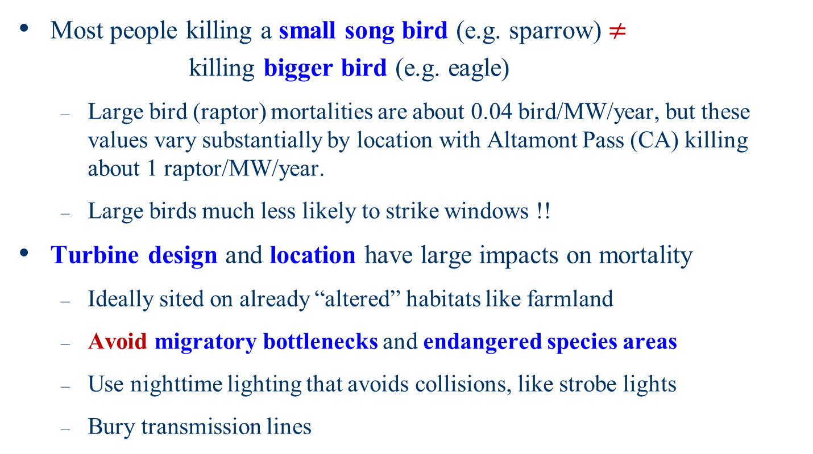
Wind Energy Impact: Birds and Bats
Most people killing a small song bird (e.g. sparrow) $≠$
killing bigger bird (e.g. eagle)
  Large bird (raptor) mortalities are about 0.04 bird/MW/year, but these values vary substantially by location with Altamont Pass (CA) killing about 1 raptor/MW/year.
  Large birds much less likely to strike windows !!
Turbine design and location have large impacts on mortality
  Ideally sited on already “altered” habitats like farmland
  Avoid migratory bottlenecks and endangered species areas
  Use nighttime lighting that avoids collisions, like strobe lights
  Bury transmission lines
Notes:
5

Slide 7
Criminal Prosecution for Wind Turbine Bird Deaths
In November 2013 Duke Energy Renewables pleaded guilty in a Wyoming U.S. District Court for violating the federal Migratory Bird Treaty Act (MBTA)
  Due to their wind turbines causing the deaths of protected birds including golden eagles
Under a plea agreement the company is paying a fine of $ 1 million, and must work to reduce bird deaths
Source: http://www.justice.gov/opa/pr/utility-company-sentenced-wyoming-killing-protected-birds-wind-projects

Slide 8
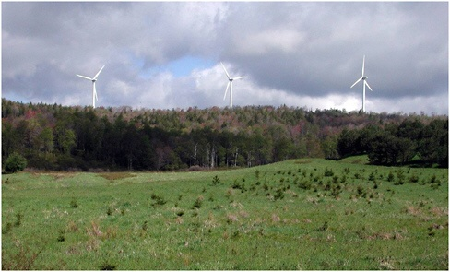
Wind Energy Impacts: Human Aesthetics
Aesthetics are often the primary human concern about wind energy projects (beauty is in the eye of the beholder); night lighting can also be an issue
Figure 4-1 of NAS Report, Mountaineer Project 0.5 miles
Notes:
7

Slide 9
Wind Energy Impacts: Human Well-Being
Wind turbines often enhance the well-being of many people (e.g., financially), but some living nearby may be affected by noise and shadow flicker
Noise sources
  gearbox/generator
  aerodynamic interaction of the blades with the wind
Noise impact is usually moderate (50-60 dB) close (40m), and lower further away (35-45 dB) at 300m
  However wind turbine frequencies also need to be considered, with both a “hum” frequency above 100 Hz, and some barely audible low frequencies (20 Hz or less)
Shadow flicker is more of an issue in high latitude countries as the lower sun casts longer shadows
Notes:
8

Slide 10
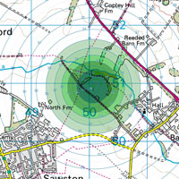
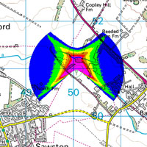
Example Noise and Shadow Flicker Maps
Source: http://www.redcotec.co.uk/renewable-energy/wind-turbine-feasibility-studies

Slide 11
Consider Before Signing Up
How much do I get and how much land will be tied up and for how long (ballpark is $7500/yr per turbine)
  Is it fixed or based on revenue?
What land rights are given up; what can I still do?
Who has what liability insurance?
What rights is the developer able to transfer without my consent?
What are termination rights? – landowner’s and developer’s
If the agreement is terminated, what happens to the wind energy structures and related facilities (they take a lot of concrete!)
Notes:
10

Slide 12
Wind Turbines and Property Taxes in Illinois
Illinois taxes property (land/buildings) at a rate equal to 1/3 its “fair cash value.”
  Personal property is not taxed (e.g., they tax your house but not what you have in your house).
Beginning in 2008, Illinois assigned a fair cash value to wind turbines at a rate of $360,000 per MW*an inflation value (set to 1.0 in 2008) minus depreciation
Property tax rates in Champaign County are around $7 to $8 /$100.
  @ $8.00, a 1.5 MW wind turbine ower pays ~ $14,400 per year
  ~ $3.65 per MWh (assuming a 30% capacity factor)

Slide 13
Wind Turbines affect Radar
“Wind Turbines interfere with radar
Thus the FAA, DHS, and DOD contest many proposed wind turbine sites.”
  Either through radar shadows, or Doppler returns that look like false aircraft or weather patterns
No fundamental constraint with respect to radar interference, but mitigation might require either radar upgrades or regulatory changes to require, for example, telemetry from wind farms to radar
Source: www.fas.org/irp/agency/dod/jason/wind.pdf (2008)

Slide 14
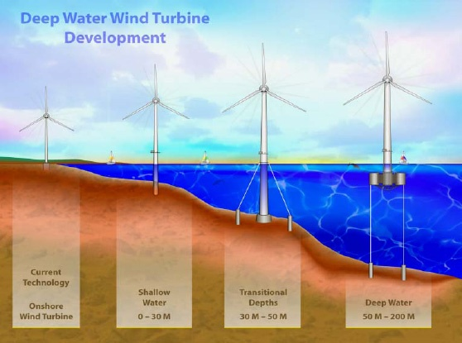
Offshore Wind
Offshore wind turbines currently need to be in relatively shallow water, so maximum distance from shore depends on the seabed
Capacity factors generally increase as turbines move further off-shore
Image Source: National Renewable Energy Laboratory
Notes:
13

Slide 15
Offshore Wind: Advantages and Disadvantages
Advantages/disadvantages are site specific
Advantages
  Can usually be sited much closer to the load (often by coast)
  Offshore wind speeds are higher and steadier
  Easier to transport large wind turbines by ship
  Minimal sound impacts and visual impacts (if far enough offshore), no land usage issues
Disadvantages
  High construction costs, particularly since they are in windy (and hence high-wave) locations
  Higher maintenance costs
  Some environmental issues (e.g., seabed disturbance)

Slide 16
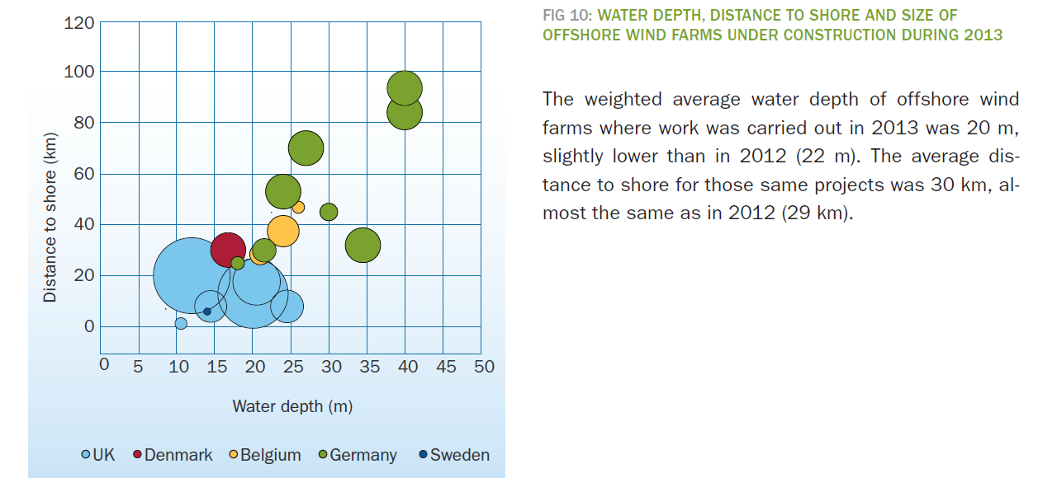
Average Depth/Distance to Shore for Europe, 2013 Construction
http://www.ewea.org/fileadmin/files/library/publications/statistics/European_offshore_statistics_2013.pdf

Slide 17
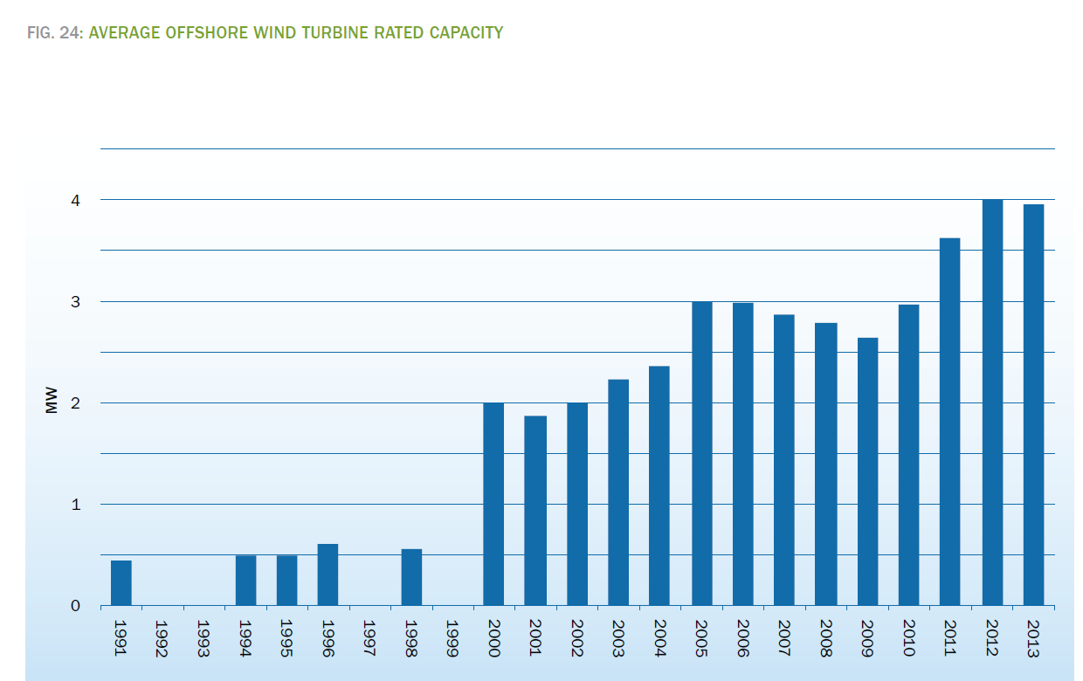
Off Shore Wind Turbine Capacity (Europe)
http://www.ewea.org/fileadmin/files/library/publications/statistics/European_offshore_statistics_2013.pdf

Slide 18
Cape Wind: US’s First Offshore Wind
130 wind turbines, producing up to 420MWs of wind energy, on Horseshoe Shoal in Nantucket Sound
Closest land would be 4.8 miles on Cape Cod, and 15.8 miles from Nantucket Island.
Project proposed in 2001; in 2010 Massachusetts approved. FAA approved 2015.
Oct ’12: Opposition groups filed suit against the project because it could impact endangered species like the right whale and sea turtles.
Dec ’17: Developer Jim Gordon pulled the plug after $100M investment, citing:
  Location – Cape Cod, Nantucket, Martha’s Vineyard.
  Shallow waters protected from wind extremes
  Deep pocket landowners strongly objected – not in my backyard

Slide 19
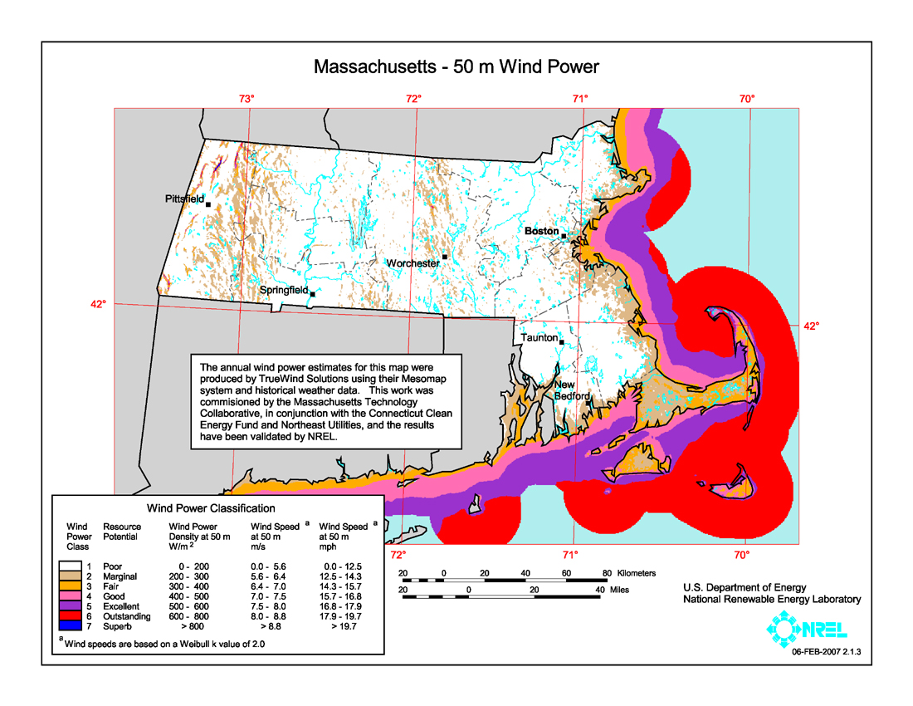
Massachusetts Wind Potential
Location
of Cape
Wind

Slide 20
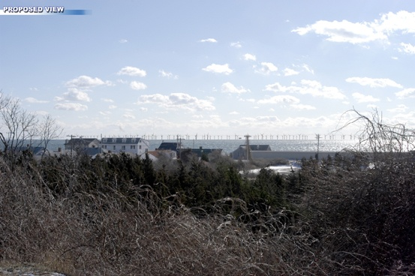
Cape Wind Simulated View, 6.5 miles
Source: www.capewind.org
Notes:
19

Slide 21
Wind Power Subsidies / Mandates
Wind power incentives are a current public policy debate
Production Tax Credit (PTC) subsidizes wind
  pays $22/MWh for the first ten years of operation
  ~ $ 4B/yr for 50 GW of wind
  Lapsed several times since inception Energy Policy Act 1992 (EPACT 92)
  Consolidated Appropriations Act, 2016 extended expiration to Dec ‘19
  Proponents say it is needed to keep wind moving forward and other sources are subsidized;
  Opponents say benefits are not worth the cost
Renewable Portfolio Standards (RPS):
  written policy requiring retail power suppliers to provide specific renewable power for specified time periods
  29 States have enacted RPS

Slide 22
Power Grid Integration of Wind Power
Wind power had represented a minority of the generation in power system interconnects, so its impact of grid operations was small
Recently the wind impact must be considered in power system analysis
  Largest wind farm in world is Roscoe Wind Farm in Texas with a total capacity of 781 MW, which matches the size of many conventional generators.
Wind power has impacts on power system operations ranging from that of transient stability (seconds) out to steady-state (power flow)
  Voltage and frequency impacts are key concerns
Notes:
21

Slide 23
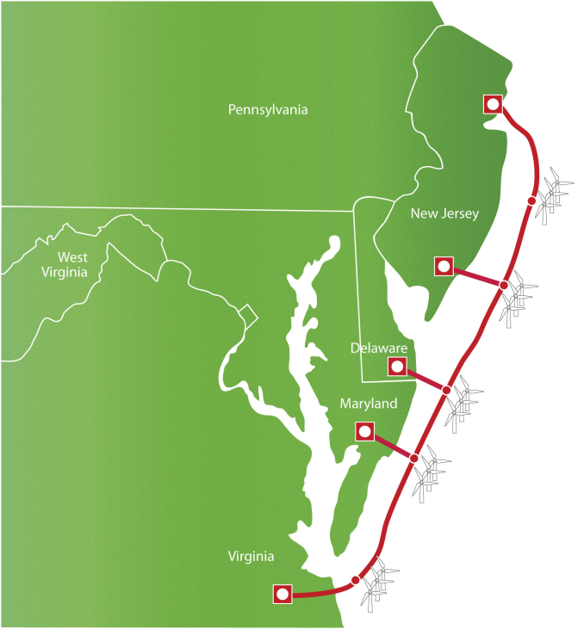
In the News: Off-shore Transmission System Proposed
Several companies, including Trans-Elect and Google are proposing a 7000 MW, 350 MW long off-shore “superhighway for clean energy.”
  It would be located between 15 to 20 miles offshore
  Would go in shallow trenches
  Five connection points to ac grid
  Original estimate was first stage
  would go into service in 2016.
  Cost is estimated at $5 billion
  Large-scale transmission projects
  have fallen on hard times recently
Source: http://atlanticwindconnection.com

Slide 24
Wind Power, Reserves, & Frequency Regulation
A key power system operations constraint is total power system generation must match total load + losses
  Excessive generation increases the system frequency
  Excessive load decreases the system frequency
Generation shortfalls can occur suddenly with the loss of a generator;
Utilities prepare for this by maintaining spinning reserves (on-line generation not fully energized) to compensate for sudden largest single generator loss
Notes:
23

Slide 25
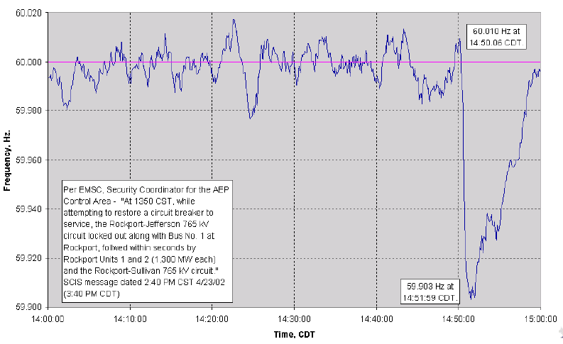
Wind Power, Reserves and Regulation, cont.
Eastern Interconnect Frequency Response for
Loss of 2600 MW;
Notes:
24

Slide 26
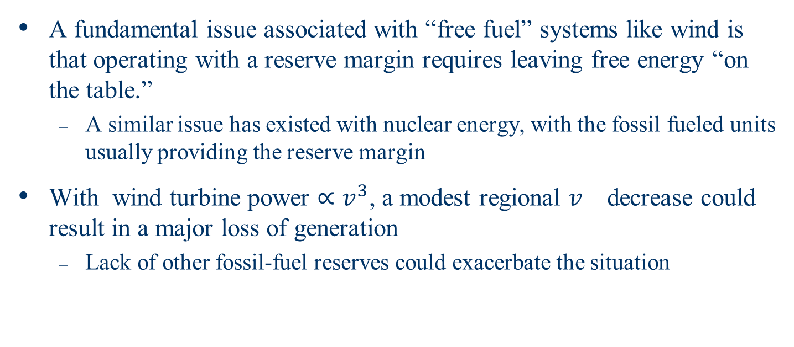
Wind Power, Reserves and Regulation, cont.
A fundamental issue associated with “free fuel” systems like wind is that operating with a reserve margin requires leaving free energy “on the table.”
  A similar issue has existed with nuclear energy, with the fossil fueled units usually providing the reserve margin
With wind turbine power ${∝v}^{3}$, a modest regional $v^{}$decrease could result in a major loss of generation
  Lack of other fossil-fuel reserves could exacerbate the situation
Notes:
25

Slide 27
Wind Power and the Power Flow
Most common power system analysis tool is the power flow (aka load flow)
  power flow determines how the power flows in a network in steady state
  Also determines all bus voltages and all currents
  A nonlinear analysis technique
  Also used for planning new generation, including wind
Notes:
26

Slide 28
Simplified Power System Modeling
Balanced 3φ systems analyzed using per phase analysis
A “per unit” normalization is simplify the analysis of systems with different voltage levels.
To provide an introduction to power flow analysis we need models for the different system devices:
  Transformers and Transmission lines, generators and loads
Transformers and transmission lines are modeled as a series impedances

Slide 29
Load Models
Ultimate goal is to supply loads with electricity at constant frequency and voltage
Electrical characteristics of individual loads matter, but usually they can only be estimated
  actual loads are constantly changing, consisting of a large number of individual devices
  only limited network observability of load characteristics
Aggregate models are typically used for analysis
Two common models
  constant power: S_{i} = P_{i} + jQ_{i}
  constant impedance: S_{i} = |V|² / Z_{i}

Slide 30
Generator Models
Engineering models depend upon application
Generators are usually synchronous machines
For generators we will use two different models:
  a steady-state model, treating the generator as a constant power source operating at a fixed voltage; this model will be used for power flow and economic analysis
  Model works fairly well for Type 3 & 4 wind turbines
  Other models include treating as constant real power with a fixed power factor.

